Slide 1
MELATONIN PRODUCT ANALYSIS
CHIRANJIT BANERJEE

Slide 2
IMPORTING AND MERGING THE DATASETS
There are total of unique data sets involved
We need to load each datasets
Remove Unnecessary columns from each datasets
Merge all the datasets into a single dataset

Slide 3
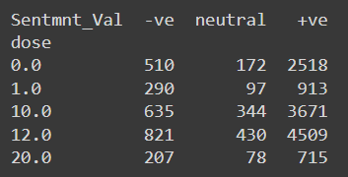
Sentiment Analysis
Extract dose from each product name and count their frequency
Check for non-numeric value products and replace them with NaN
Recheck the values, additional row or 0 mg product also get displayed
Converting the “review_rating” column into bins
Based on the bins, assigning +ve, neutral, -ve sentiment to each entry
Storing the entire thing in a list and converting it to a data frame

Slide 4
TEXT BLOB
Text blob is a powerful, robus NLP library in python that provided range of functionalities beyond string manipulation
It significantly amplifies as well simplifies sentiment analysis by leveraging :
1. Pretrained models, 2. Contextual understanding, 3. Comprehensive lexion
It provides accurate and efficient sentiment scores with minimal effort, while basic string analysis lacks the depth, accuracy, and ease of use needed for effective sentiment analysis.
Alternate to Text Blob : VADER, Transformer (2 most industrially popular models)

Slide 5
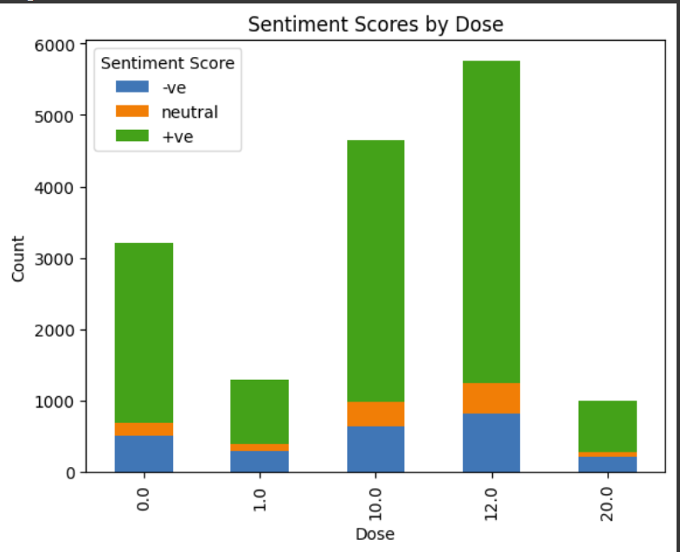
DOSE-WISE SENTIMENT ANALYSIS
Basically in this step er convert the string in each row into a text blob object and then sentiment analysis is performed on each of them.
Based on the content of each text blob and rendering to the lexion, each and every review will be assigned a number ranging [1,1], this number is basically a magnitude of the sentiment associated with the comment

Slide 6
TEXT ANALYSIS
STOP WORDS & HOT WORDS
STOP WORDS :
Examples:
In English, stop words typically include:
Articles: "a", "an", "the"
Prepositions: "in", "on", "at"
Conjunctions: "and", "but", "or"
Pronouns: "he", "she", "it", "they"
Other common words: "is", "am", "are", "this", "that"
These words are later removed from the text as they are not used in analysis
HOT WORDS :
Examples:
In a dataset of product reviews, hot words might include:
Positive terms: "good", "great", "excellent", "love"
Negative terms: "bad", "poor", "terrible", "hate"
Product-specific terms: "battery", "screen", "price", "quality"
Purpose:
Identifying hot words helps in choosing words for text analysis

Slide 7
STEPS INVOLVED :
STOP WORDS DETECTION AND REMOVAL
The stopwords( ) module is called a list named “s_wds “ created and contains all stop words
A new column named “df_8_merged['new_reviewed_text']” is created that contains all the reviews without the stop words
This is done by converting each review into lower case, splitting it into individual words and then comparing it with the list of stop words, if present they are removed, else kept in the review.
Finally they are merged back and stored in the new column
Also a new column is created where stop words corresponding to each row are stored and lated displayed for our reference and clarification

Slide 8
STEPS INVOLVED :
HOT WORDS DETECTION
This time, we refer to the newly created column df[‘r_wrds’]
This list does not contain the stop words, this is done to lower the processing time.
We use feature_extraction.text library from sklearn to create a CountVectorizer() object
The object created does two things :
Analyzes the text data from each row and learns vocabulary from text
Transforms the text into a sparse matrix where each columns corresponds to a word from the vocabulary and each row corresponds to each review
From this matrix, a total of 10 words are generated (we had set the parameter to 10)
There are 2 types of visuals provided , one is : overall, and other is dose wise

Slide 9
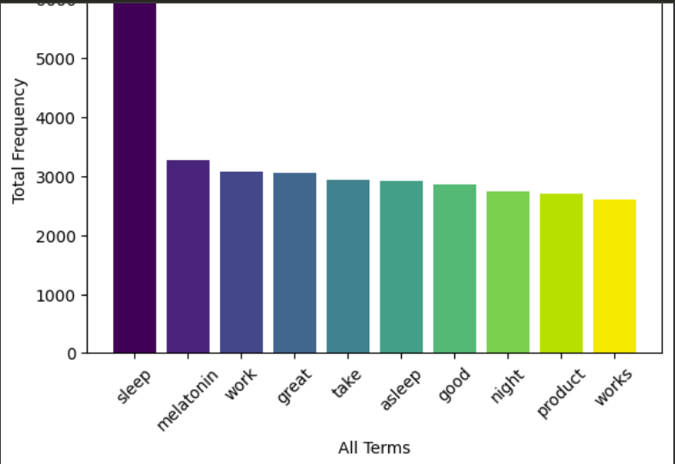
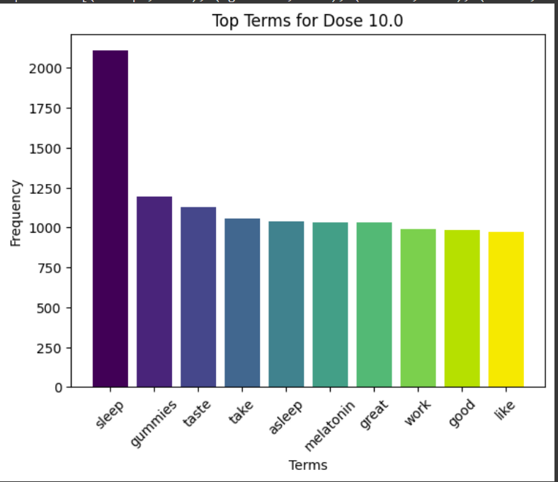
OVERALL AND DOSE WISE HOT WORDS

Slide 10
FEATURE ENGINEERING
Now out of so many feature, 3 features and one target variables are set.
Feature Variables involve :
1.'average_rating', 2. 'Sentmnt_Val', 3. 'New_reviewed_text'
Target Variable involve : “Dose”

Slide 11
MACHINE LEARNING
THERE ARE TOTAL OF 3 Algorithms used :
Grid Search : For finding the BEST parameters (hyperparameter tuning)
Random Forest Regression Algorithm
Logistic Regression Algorithm
The main of using Machine Learning Algorithm is to predict the product based on the input parameters provided

Slide 12
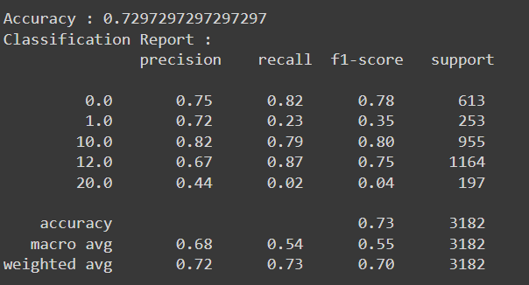
Logistic Regression Algorithm
In this the grid search algorithm was used and only the best parameters were chosen using hyper-parameter tuning .
The parameters used were :
C
Penaulty
Solver
max_iter

Slide 13
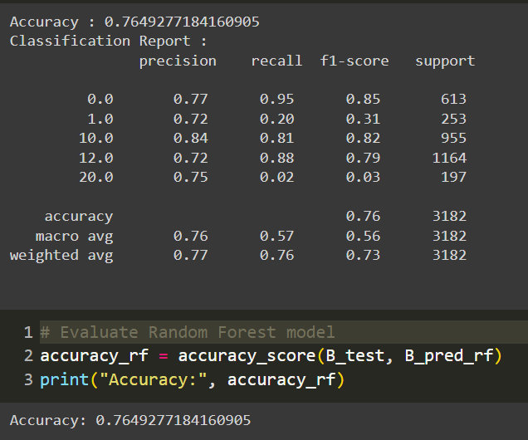
Random Forest Regression Algorithm
Parameters used :
N_estimators
Max_depth
min_sample_split

Slide 14
THANK YOU

